Slide 1
Artificial Intelligence & Machine Learning

Slide 2
Lecture - 3
What Linear Regression?
Line Of Best Fit
Steps to Compute the Line Of Best Fit
The Linear Regression method with an example
A python program to implement Least Squares method
Polynomial Regression with Example

Slide 3
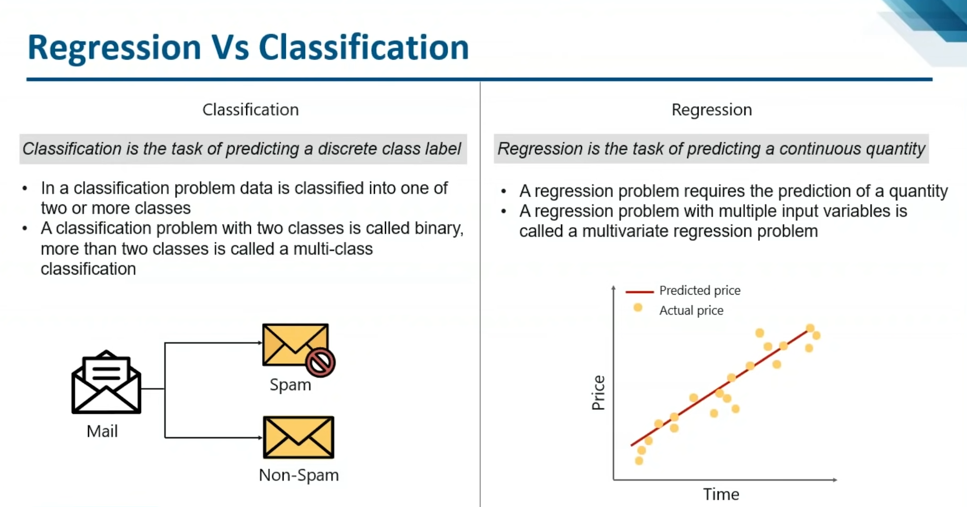
Linear Regression

Slide 4
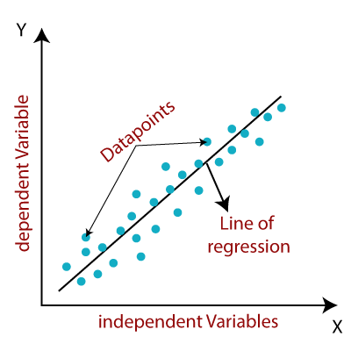
Linear Regression
What is
Linear Regression ?
It is a method to establish a linear relationship between a dependent (y) and one or more independent (x) variables, hence called as linear regression.
The least-squares regression/Linear Regression method is a technique commonly used in Regression Analysis.
It is a mathematical method used to find the best fit line that represents the relationship between an independent and dependent variable.

Slide 5

Linear Regression
What is
Linear Regression ?
$$Y=mx+c+ε$$
Here,
Y= Dependent Variable (Target Variable)
X= Independent Variable (predictor Variable)
c= intercept of the line (Gives an additional degree of freedom)
m = Linear regression coefficient (scale factor to each input value).
ε = random error

Slide 6
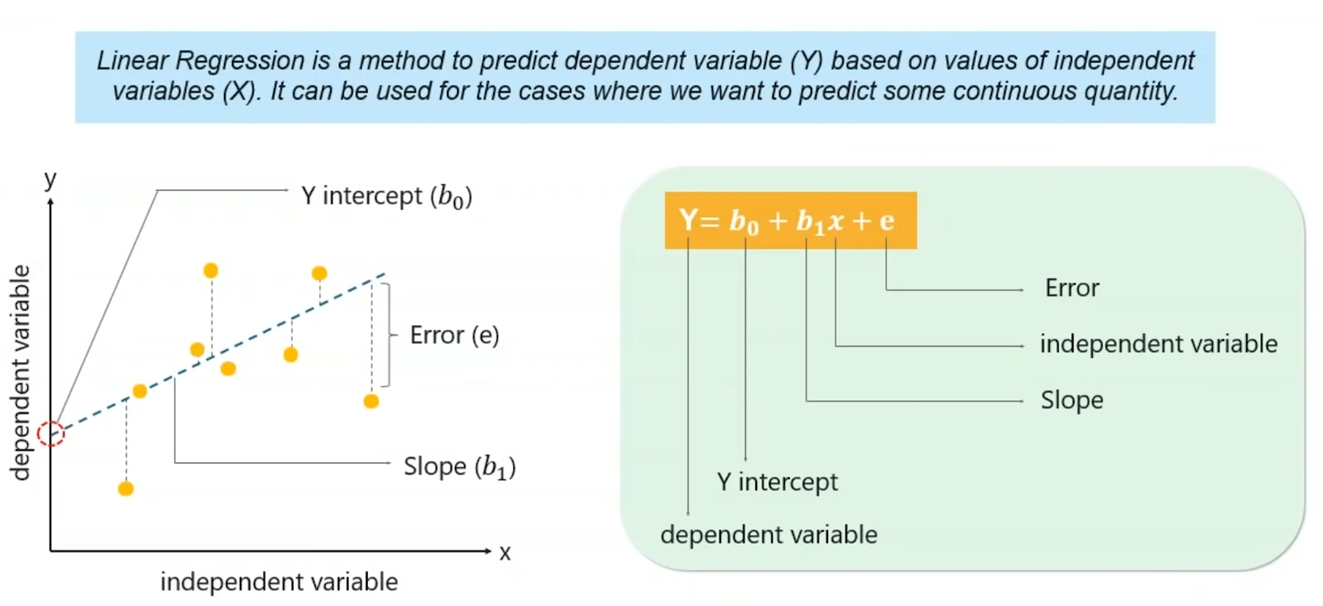
Linear Regression

Slide 7
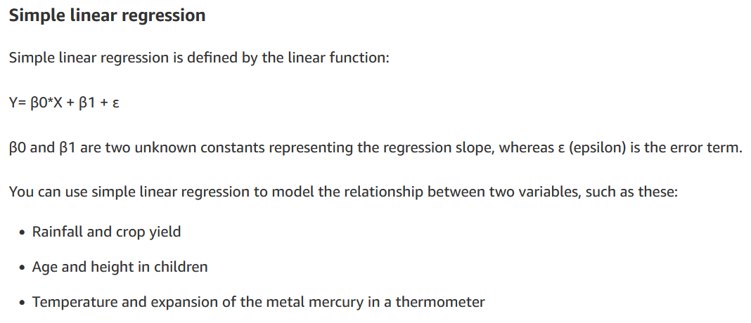






Linear Regression
Types of
Linear Regression ?

Slide 8
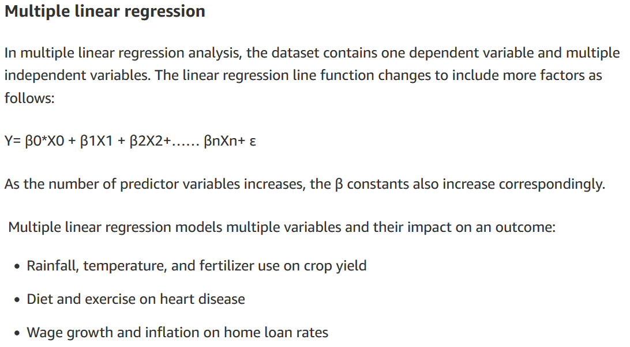




Linear Regression
Types of
Linear Regression ?

Slide 9
Linear Regression
Why LR is Used ?
The LR is a statistical method used to find the line of best fit of the form of an equation such as y = mx + c to the given data.
The curve of the equation is called the regression line. Our main objective in this method is to reduce the sum of the squares of errors as much as possible.
This method is often used in data fitting where the best fit result is assumed to reduce the sum of squared errors that is considered to be the difference between the observed values and corresponding fitted value.
The sum of squared errors helps in finding the variation in observed data.
Line of best fit is drawn to represent the relationship between 2 or more variables (shown in scatter plot of data points).
It is based on the idea that the square of the errors obtained must be minimized to the most possible extent and hence the name least squares method.

Slide 10
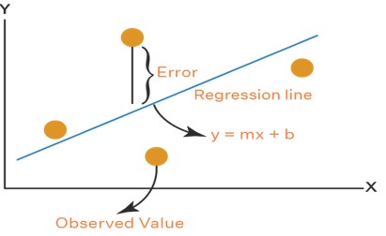
Linear Regression
What is the Line Of Best Fit?
Let us assume that the given points of data are (x1, y1), (x2, y2), (x3, y3), …, (xn, yn) in which all x’s are independent variables, while all y’s are dependent ones.
This method is used to find a linear line of the form y = mx + c, where y and x are variables, m is the slope, and c is the y-intercept.

Slide 11

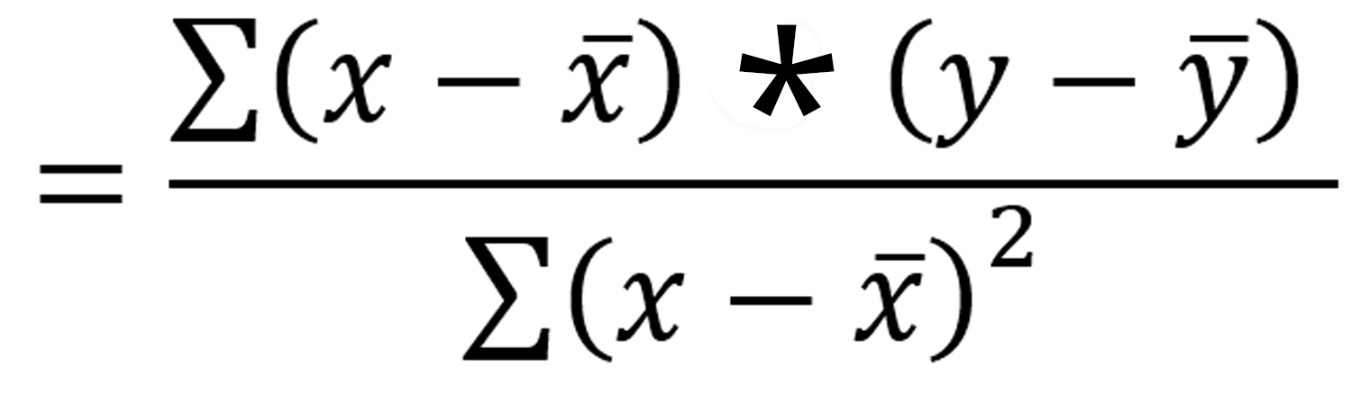


Linear Regression
Steps to Find
Line Of Best Fit?
As an assumption, let’s consider that there are ‘n’ data points.
Step 1: Calculate the slope ‘m’ by using the following formula:
Step 2: Compute the y-intercept (the value of y at the point where the line crosses the y-axis):
Step 3: Substitute the values in the final equation:
Now let’s look at an example and see how you can use the least-squares regression method to compute the line of best fit.
Means, C = (∑y – m ∑x) / n

Slide 12
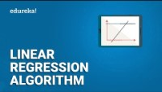
Linear Regression

Slide 13
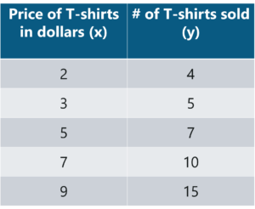
Linear Regression
Tom who is the owner of a retail shop, found the price of different T-shirts vs the number of T-shirts sold at his shop over a period of one week. He tabulated this like shown below
Let us use the concept of least squares regression to find the line of best fit for the given data.
Example

Slide 14
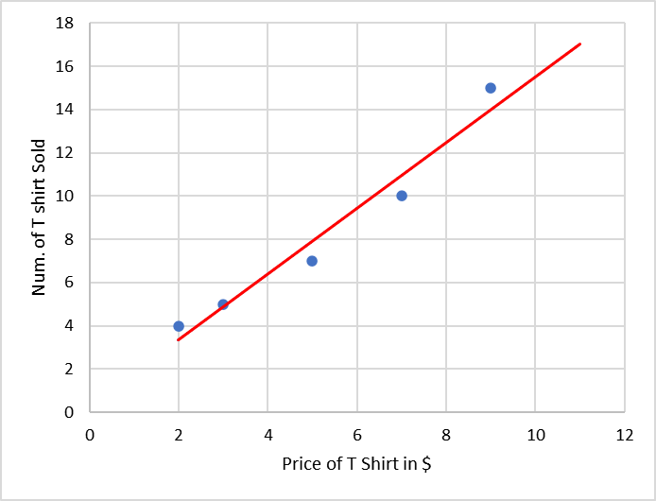
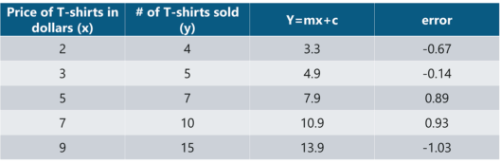
Linear Regression
Example
Now one can use the above equation (y=mx + c) to estimate how many T-shirts of price $8 can he sell at the retail shop.
y = (1.518)(8) + 0.305 = 12.45 T-shirts
This comes down to 13 T-shirts! That’s how simple it is to make predictions using Linear Regression.

Slide 15

Linear Regression
Implementation
Logic: To implement Least Squares method in order to build a model that studies the relationship between an independent and dependent variable.
The model will be evaluated by using least square regression method where RMSE and R-squared will be the model evaluation parameters.
Step 1: Import the required libraries
Step 2: Import the data set
Step 3: Assigning ‘X’ as independent variable and ‘Y’ as dependent variable
Step 4: Calculate the values of the slope and y-intercept
Step 5: Plotting the line of best fit
Step 6: Model Evaluation

Slide 16
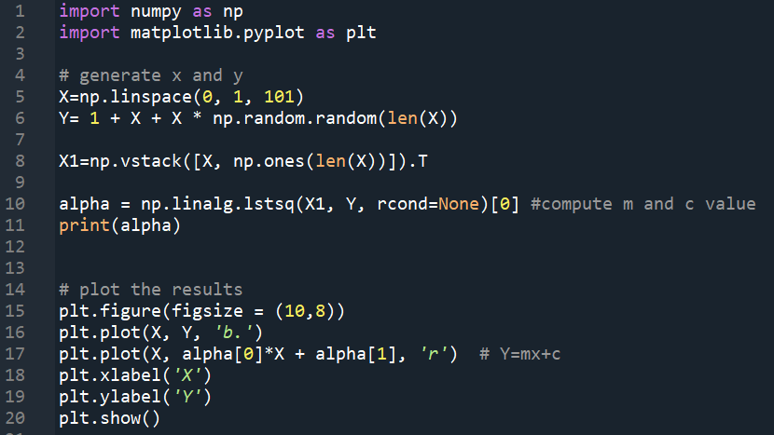
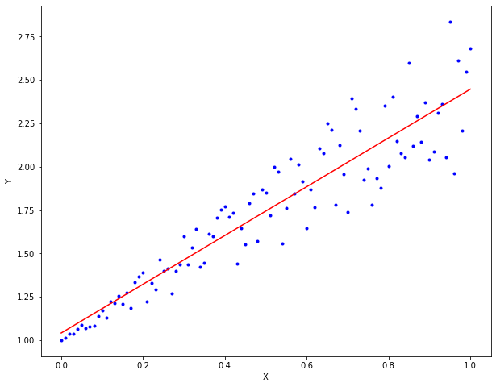
Linear Regression

Slide 17
Polynomial Regression
Polynomial Regression

Slide 18
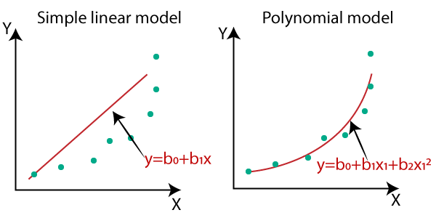
Polynomial Regression
Why Polynomial Regression?
A simple linear regression algorithm only works when the relationship between the data is linear.
But suppose we have non-linear data, then linear regression will not be able to draw a best-fit line.

Slide 19
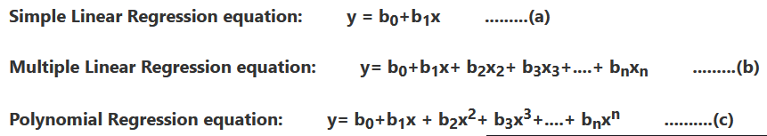
Polynomial Regression
How it Handle Non-Linear Data?
Polynomial regression is a form of Linear regression where only due to the Non-linear relationship between dependent and independent variables, we add some polynomial terms to linear regression to convert it into Polynomial regression.

Slide 20
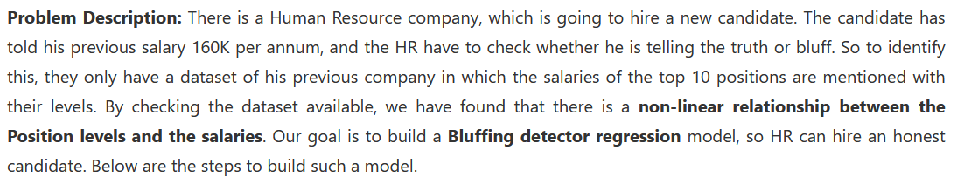
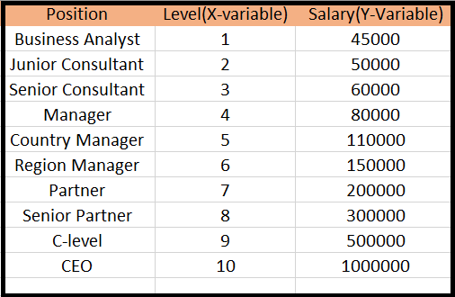
Polynomial Regression
Implementation of Polynomial Regression

Slide 21
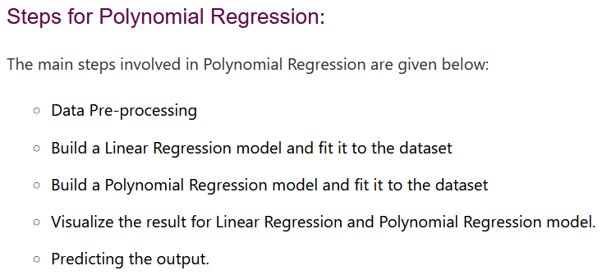
Polynomial Regression

Slide 22
Polynomial Regression
# importing libraries
import numpy as nm
import matplotlib.pyplot as mtp
import pandas as pd
#importing datasets
data_set= pd.read_csv('Position_Salaries.csv')
#Extracting Independent and dependent Variable
x= data_set.iloc[:, 1:2].values
y= data_set.iloc[:, 2].values
#Fitting the Linear Regression to the dataset
from sklearn.linear_model import LinearRegression
lin_regs= LinearRegression()
lin_regs.fit(x,y)

Slide 23
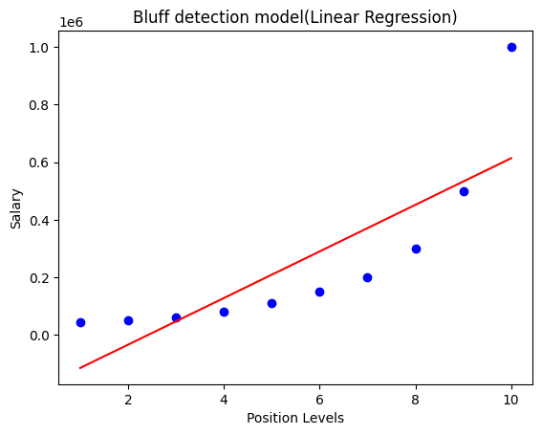
Polynomial Regression
#Visulaizing the result for Linear Regression model
mtp.scatter(x,y,color="blue")
mtp.plot(x,lin_regs.predict(x), color="red")
mtp.title("Bluff detection model(Linear Regression)")
mtp.xlabel("Position Levels")
mtp.ylabel("Salary")
mtp.show()

Slide 24
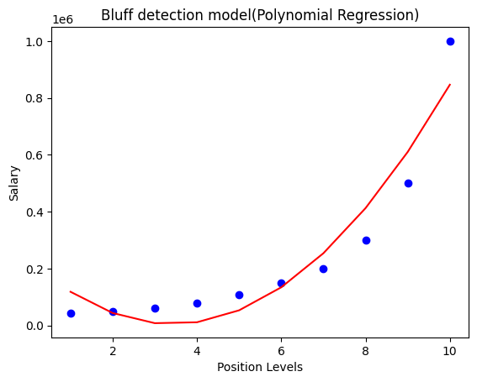
Polynomial Regression
#Fitting the Polynomial regression to the dataset
from sklearn.preprocessing import PolynomialFeatures
poly_regs= PolynomialFeatures(degree= 2)
x_poly= poly_regs.fit_transform(x)
lin_reg_2 =LinearRegression()
lin_reg_2.fit(x_poly, y)
#Visulaizing the result for Polynomial Regression
mtp.scatter(x,y,color="blue")
mtp.plot(x, lin_reg_2.predict(poly_regs.fit_transform(x)), color="red")
mtp.title("Bluff detection model(Polynomial Regression)")
mtp.xlabel("Position Levels")
mtp.ylabel("Salary")
mtp.show()

Slide 25
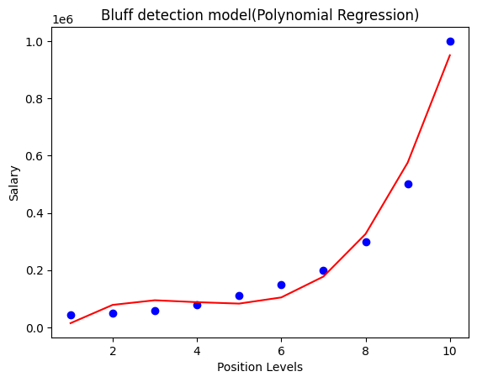
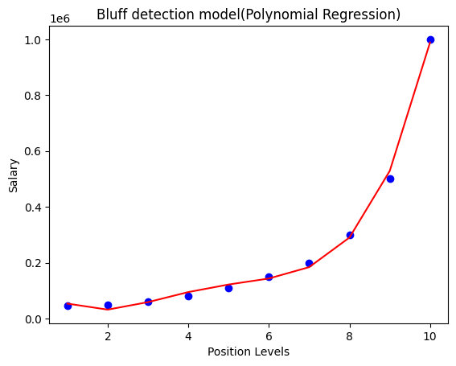
Polynomial Regression
Degree = 2 Degree = 3 Degree = 4

Slide 26
Linear Regression, Polynomial Regression
Linear Regression
https://www.geeksforgeeks.org/ml-linear-regression/
Master Polynomial Regression With Easy-to-Follow Tutorials
https://www.analyticsvidhya.com/blog/2021/07/all-you-need-to-know-about-polynomial-regression/
Polynomial Regression
https://www.javatpoint.com/machine-learning-polynomial-regression
Python | Implementation of Polynomial Regression
https://www.geeksforgeeks.org/python-implementation-of-polynomial-regression/
Machine Learning - Polynomial Regression
https://www.w3schools.com/python/python_ml_polynomial_regression.asp

